Slide 1
CAMPUS CARRY
TASK FORCE
ORGANIZATIONAL MEETING
SEPTEMBER 8, 2016

Slide 2
Campus Carry Task Force Members
Task Force Chair – Dr. Vicki Stanfield
President – Dr. A. Rodney Allbright
Executive Staff – Dr. Clen Burton, Jim Tagliareni, Mary Ann Amelang
Childcare Center – Anna Raumaker
Classified Staff Council – Sally Austin
Collegiate High School – Sandy Belcher
Communications – Chris Carpenter
Cosmetology – Jamie Hunsucker
Dual Credit – Theresa Jones
Emergency Management – Trish McIntosh, Bill Roy
Facilities – Charlie King
Faculty Senate – Sean Skipworth
Gulf Coast Safety Institute – Cindy Lewis
Human Resources – Lonica Bush
Information Technology Services- Courtney Moore
Institutional Research- Dr. Teri Walker
Instruction – Dr. Steve Sewell and Dr. Carla Boone
Library – Kathryn Park
North County – Christina Bergvall
Police – Chief Chapa, Lt. Meyers, Lt. Hamm, Sgt. Walker
Professional Staff Council – Matthew Busby
Purchasing – Sonja Blinka
Senior Program – Alicia Vardeman-Aulds
Students – Samuel Parada, SGA President
Student Services – Kris Kimbark, Kelly Musick, Leanne Downton

Slide 3
Charge to the Task Force
The task force will help develop reasonable rules based upon input obtained from campus constituents that are compliant with Senate Bill 11 and address the safety and welfare of students and the campus community.

Slide 4
Campus Carry Law
June 13, 2015 Governor Greg Abbott signed into law Senate Bill No. 11 (S.B. 11), also known as the "campus carry" law. S.B. 11 amends Section 411.2031 of the Texas Government Code to allow carrying of handguns by license holders on Community College campuses beginning on August 1, 2017.
While the College President may not generally prohibit license holders from carrying concealed weapons on the campus, the law gives public Colleges some discretion to regulate campus carry including designating certain areas on campus where concealed handguns are prohibited. The law authorizes the College to adopt and receive approval of its campus carry policy from the Board of Trustees by August 1, 2017.

Slide 5
Campus Carry vs. Open Carry
What does the Legislation say?
Campus Carry
Effective August 1, 2016 (4 year institutions); August 1, 2017 (2 year institutions); individuals who have a valid Texas handgun license may carry a concealed handgun on college campuses in certain areas so long as the area has not been designated by the school as a weapons free area. A person must be at least 21 years of age, undergo training and meet other statutory requirements to obtain a concealed handgun license in the State of Texas.
See Senate Bill 11; Texas Government Code 411.2031(b); Texas Penal Code 46.03(a)(1)(B)
Open Carry
Effective January 1, 2016, holders of a handgun license may now carry their handgun visibly in a waist belt, holster or a should holster, but they may not openly carry on or in a college campus or building and they may not openly carry on any public or private driveway, street, sidewalk or walkway, parking lot, parking garage or other parking area of the college.
See House Bill 910; Texas Penal Code 46.15(b)(6)

Slide 6
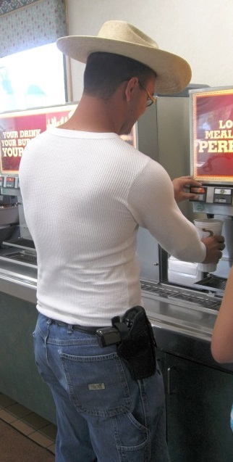
Open Carry vs. Concealed Carry
Open Carry is prohibited for all persons, including license holders, on campus premises

Slide 7
Gun-Free Zone Designation
Senate Bill 11 allows the College District President to identify areas where concealed handguns are prohibited.
Considerations:
Nature of the Student Population
Specific Safety Considerations - Locations where extreme psychological and/or emotional stress might temporarily impair judgment?
Uniqueness of the Campus Environment - Where negligent handling of a weapon would result in potential catastrophic harm?
What similar events and/or locations exist where a license to carry (LTC), formerly concealed handgun license (CHL) holder cannot carry under current law?

Slide 8
Guns Currently Prohibited
The following premises are currently prohibited by state law:
Polling places on the day of elections and while early voting is in progress
Meetings of governmental entities that are subject to the Texas Open Meetings Act, if the entity chooses to post a notice under Penal Code § 30.06
Intercollegiate Athletic Events

Slide 9
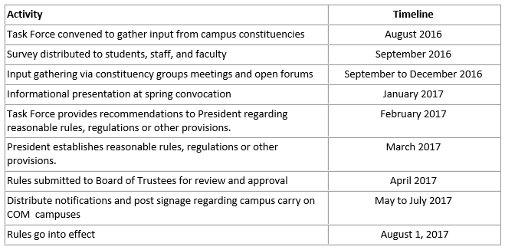
Campus Carry Task Force Activity Timeline

Slide 10
SUB-COMMITTEES

Slide 11
Data Gathering
Dr. Vicki Stanfield - Vice President for Student Services
Chief Sylvia Chapa - Chief of Police
Lonica Bush - Director of Diversity & Equity
Trish McIntosh - Emergency Management Coordinator
Review other colleges/universities websites
Create e-survey
Forums
Activity | Date/Time | Location
President and Executive Staff | TBA | TBA
Faculty Senate | October 6 at 12:30 p.m. | LRC-257
Student Government Association | September 6 at 12:30 p.m. | Admin. Boardroom
Classified Council | September 13 at 2 p.m. | LRC-131
Professional Council | TBA | TBA
Student Forum (Combined with Student Concerns Forum) | October 13 from 12:30-1:30 p.m. | LRC-131
Faculty and Staff Forum | TBA from 3-4 p.m. | TBA
Faculty, Staff, Student, Community Forum (Evening) | TBA from 6-7 p.m. | TBA

Slide 12
Communications
Mary Ann Amelang – VP for Institutional Advancement
Chris Carpenter – Full Stack Developer/Web Designer
Letter from President
Post webpage content
Social media, news releases, employee newsletter
Spring convocation

Slide 13
Facilities & Purchasing
Charlie King – Director of Facilities
Sonja Blinka – Director of Purchasing
Signage/Logistics
Purchasing
Installation

Slide 14
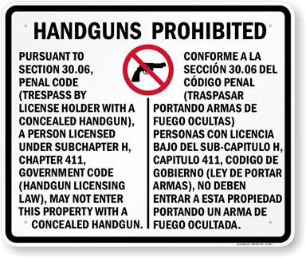
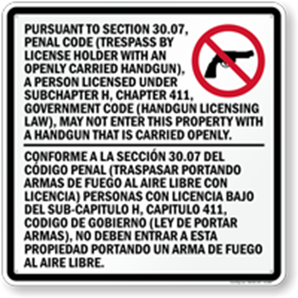

Slide 15
Policy
Dr. Vicki Stanfield
Lonica Bush
Identify gun-free zones
Draft policy
Review by President, executive staff, task force
Final approval by Board of Trustees

Slide 16
Training
Lonica Bush – Director of Diversity & Equity
Dr. Kris Kimbark – Dean of Students
Chief Sylvia Chapa – Chief of Police
Employees
Students

Slide 17
Open Discussion

